Slide 1
Chapter 28

Slide 2
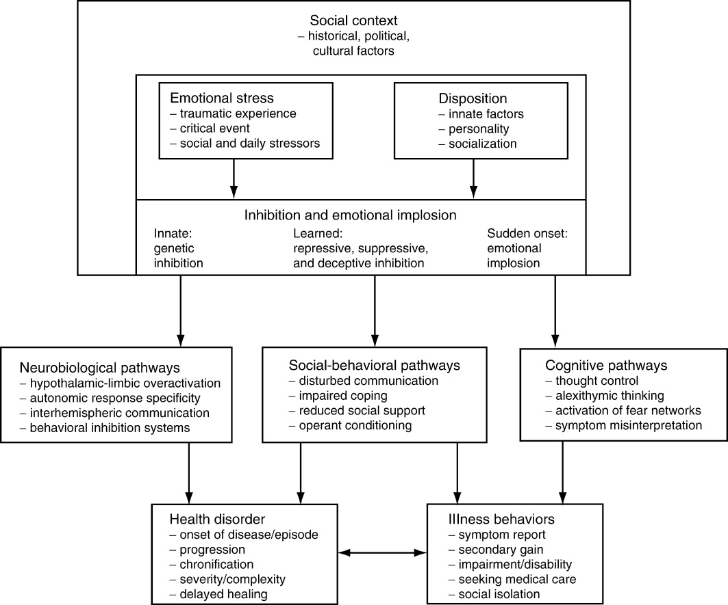
Figure 1 Psychological pathway model of emotional inhibition with neurobiological, social-behavioral, and cognitive pathways between stress/disposition, emotional processing, and subsequent health disorders or illness behaviors.
Adapted from Traue.³

